Slide 1
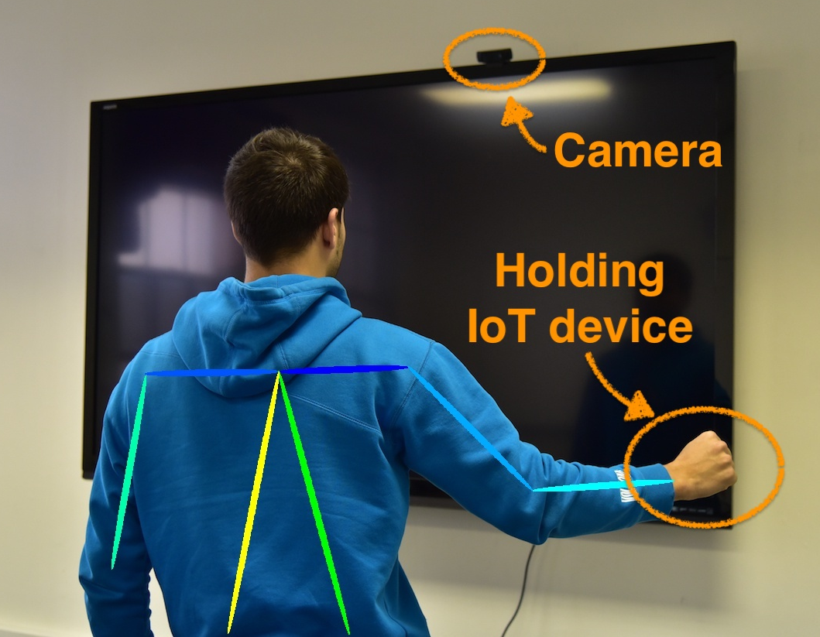
PosePair++: Secure Pairing via Video and IMU Verification
Carlos Ruiz, Shijia Pan, Hae Young Noh, Pei Zhang, Jun Han
IoT devices getting lower in size, power, resources...
How to pair them? ➙ Compare IMU vs camera motion
How secure is this approach? ➙ Come try our demo!

